Slide 1
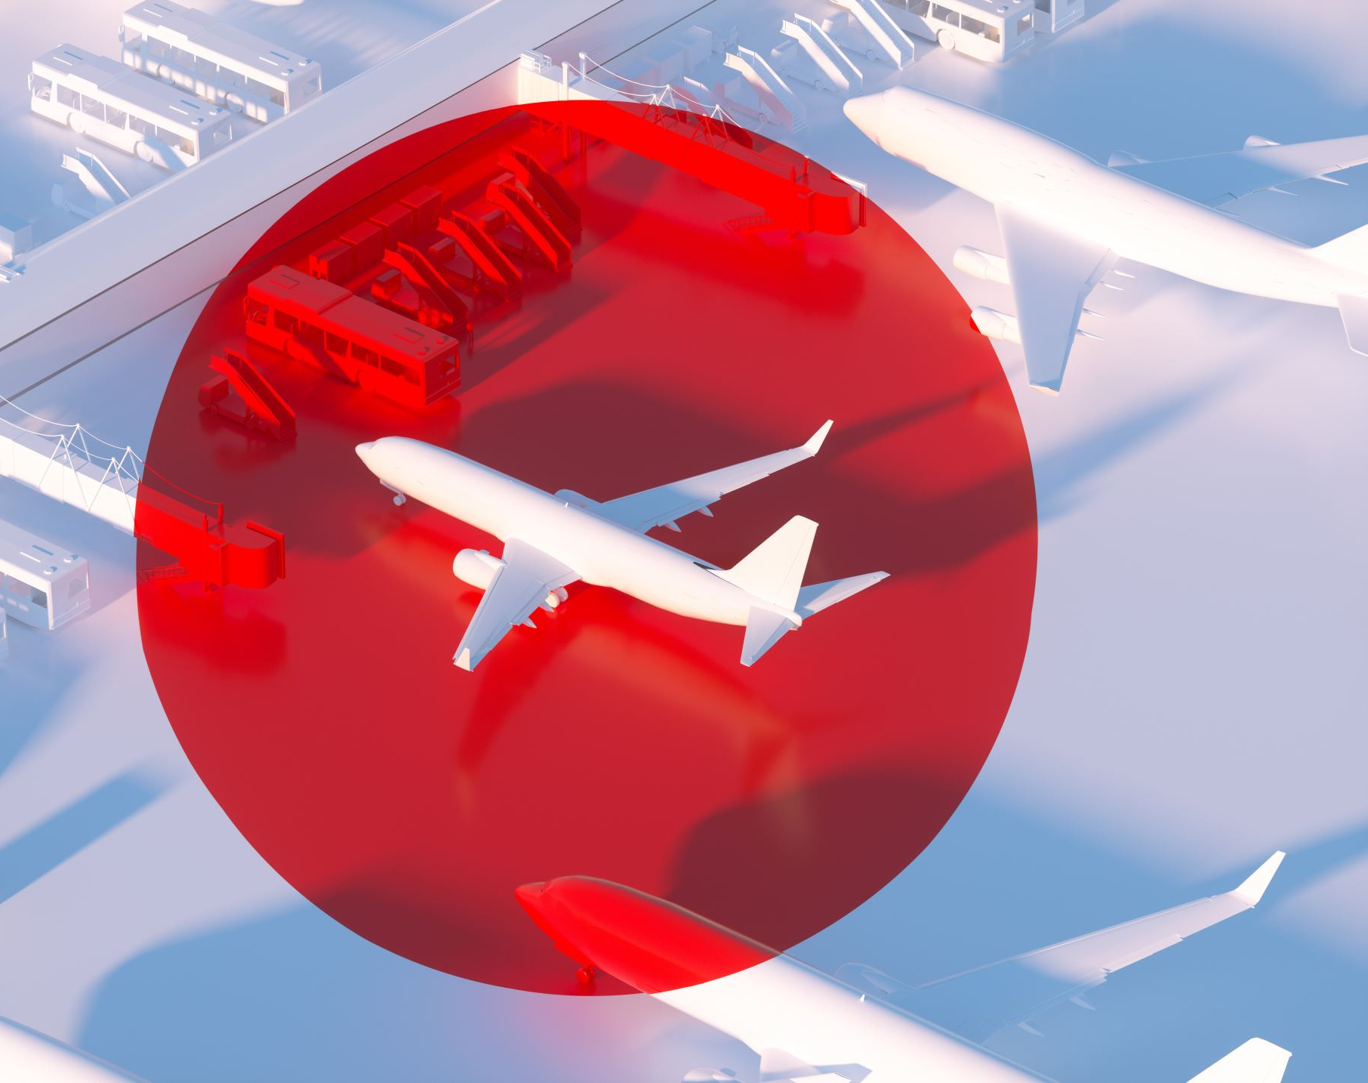
BRITISH AIRWAYS ANALYSIS USING WEB SCRAPING
BY: Vinay Meesaraganda

Slide 2
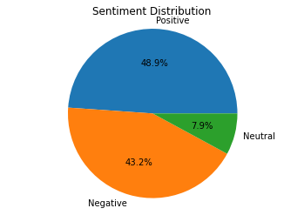
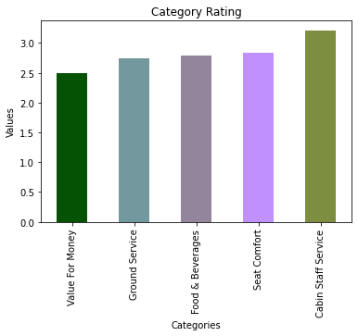
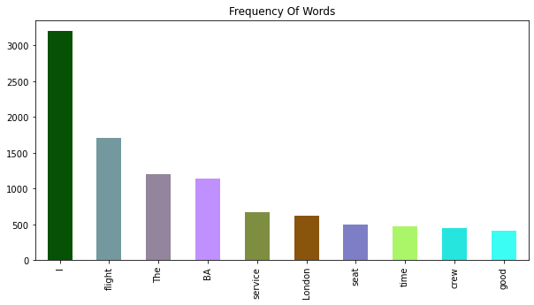
Sentiment Distribution
Out of 1000 reviews 48.9 % are positive,43.2% are Negative and 7.9% are Neutral
Customer Rating
The average travel experience rating comparison include “Value for Money”, “Ground Service”, “Food & Beverages”, “Seat Comfort”, “Cabin Staff Service”.
Key Topics
The below chart describes about the Frequency Distribution of words in the reviews displaying people are actively talking about their experience

